Slide 1

Optimising Spark for Large-Scale Data Processing

Slide 2


Course: Data Engineering - II
Lecture On: Optimising Network IO for Spark
Instructor: Vishwa Mohan

Slide 3
UNDERSTANDING NETWORK IO IN SPARK
Network IO
Time attributed to sending data between monitored processes
Shuffles
Shuffles
Occurs whenever data has to be rearranged across the various partitions

Slide 4
UNDERSTANDING NETWORK IO IN SPARK
How do we reduce Shuffles?
Optimising Joins
Avoiding Wide Transformations
Example: groupByKey(),
Sorting

Slide 5
UNDERSTANDING NETWORK IO IN SPARK
Data Locality
Keeps IO operations within a single physical Node thus avoiding processing overhead of the n/w stack

Slide 6


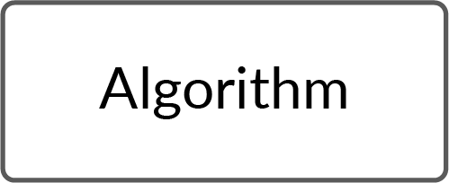


UNDERSTANDING NETWORK IO IN SPARK
Servers

Slide 7
REDUCING NETWORK IO
Worker Node
Partitioning
Proper partitioning helps in avoiding unnecessary shuffles.
Also, during joins if the same partitioner is used then the data from the 2 tables will be lying in the same machines and so shuffling will be reduced
1
2
This is one partition.

Slide 8
REDUCING NETWORK IO
Avoiding wide transformations
Transformations like groupByKey() should be avoided
Using broadcast Joins
Reduces the number of shuffles in a join operation

Slide 9
UNDERSTANDING SHUFFLES
cogroup
join
groupByKey
reduceByKey
joinByKey
sortByKey
distinct
intersection
repartition
coalesce
Shuffles
Mechanism of regrouping and redistributing data

Slide 10
UNDERSTANDING SHUFFLES
Worker Node
Worker Node
Worker Node
(a,1)
(a,5)
(b,6)
(b,4)
(a,1)
(a,1)
(b,1)
(a,2)
(b,1)
Worker Node
Worker Node
(a,1)
(a,1)
(a,2)
(a,1)
(a,5)
(b,1)
(b,1)
(b,6)
(b,4)
(a,10)
(b,12)

Slide 11
TECHNIQUES TO REDUCE SHUFFLING
01
Partitioning
02
Broadcast join whenever possible
03
Using reduceByKey() over groupByKey()

Slide 12
OPTIMISING JOINS
How does Joins affect Network IO?
Joins cause shuffling of data.
In an ETL application, Joins is one of the most commonly used and the heaviest in terms of compute load.
Traditionally, in Shuffle Hash Join, the data is shuffled across the partitions.
Hash Tables are also created in this method which is another very expensive operation.

Slide 13
OPTIMISING JOINS
RDD1
RDD2
Shuffle RDD1.join(RDD2)
Child

Slide 14
OPTIMISING JOINS
Inner-Join
Left-Join
Right-Join
Outer-Join
Cross-Join
Left-Semi-Join
Left-Anti-Semi-Join
Currently Spark offers the following type of Joins

Slide 15
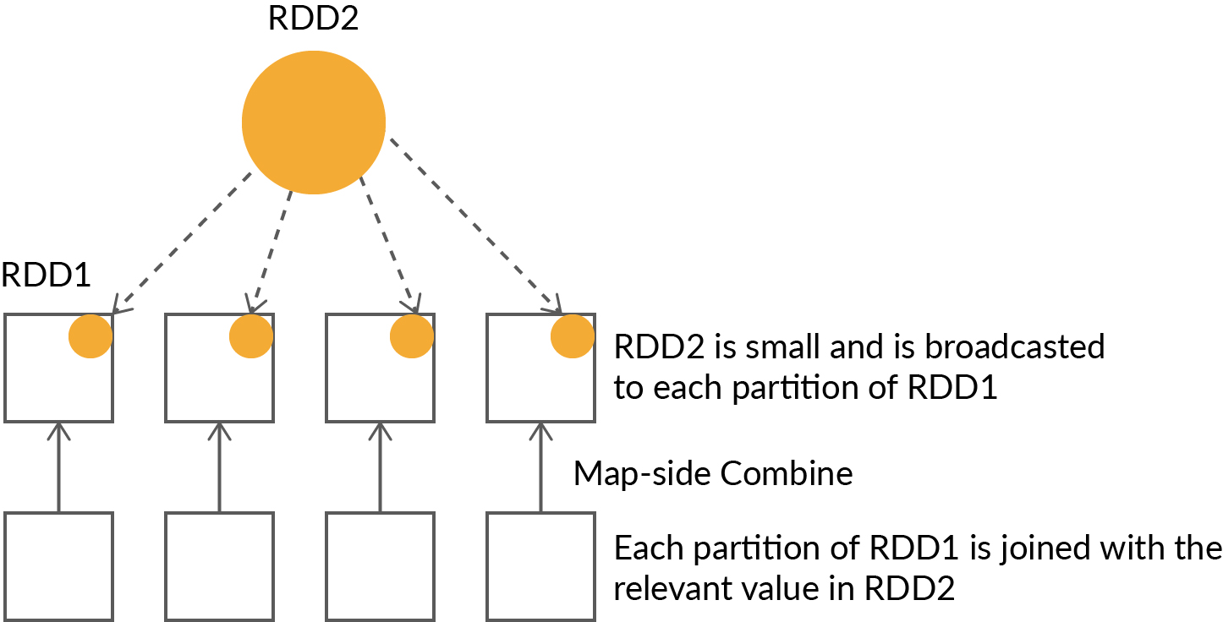
OPTIMISING JOINS

Slide 16
DATA PARTITIONING IN SPARK
How does Partitioning help in reducing the network IO?
Having the correct no. of partitions and correct practitioner reduces shuffling in the case of wider transformations.
Using a custom practitioner in case of joins helps in significantly reducing the volume of data being shuffled
Process of dividing data into number of sections called as partitions
No. of executors, cores and partitions will directly affect the degree of parallelism in Spark Jobs

Slide 17
OPERATIONS BENEFITTED BY PARTITIONING
01
groupByKey()
02
reduceByKey()
03
Join Operations

Slide 18
OPERATIONS AFFECTING PARTITIONS
Q1
Repartitioning
Can be used to increase or decrease the no. of partitions. In this a full shuffle of data is done.
A:
Q2
Coalesce
Reduces the number of partitions but the movement of data across partitions is lower as compared to Repartitioning
A:

Slide 19
OPERATIONS AFFECTING PARTITIONS
Partition A: 1, 2, 3 Partition B: 4, 5 Partition C: 6, 7, 8 Partition D: 9, 10
Partition A: 1, 2, 3, 4, 5 Partition C: 6, 7, 8, 9, 10
df.coalesce(2)
Partition A: 1, 2, 3 Partition B: 4, 5 Partition C: 6, 7, 8 Partition D: 9, 10
Partition X: 1, 3, 5, 7, 9 Partition Y: 2, 4, 6, 8, 10
df.repartition(2)

Slide 20
HOW TO CHOOSE THE RIGHT PARTITIONING CRITERIA?
The partition key and size should be optimal so that the data is distributed more or less equally among all the partitions.
No. of partitions should be greater than no. of cores. Typically around 2-3 times the no. of cores.
When working with a DataFrames for example, we need to find the balance in the number of partitions
Too many partitions will lead to overload of metadata and too less will lead to big chunks of data leading to memory stress.

